Slide 1
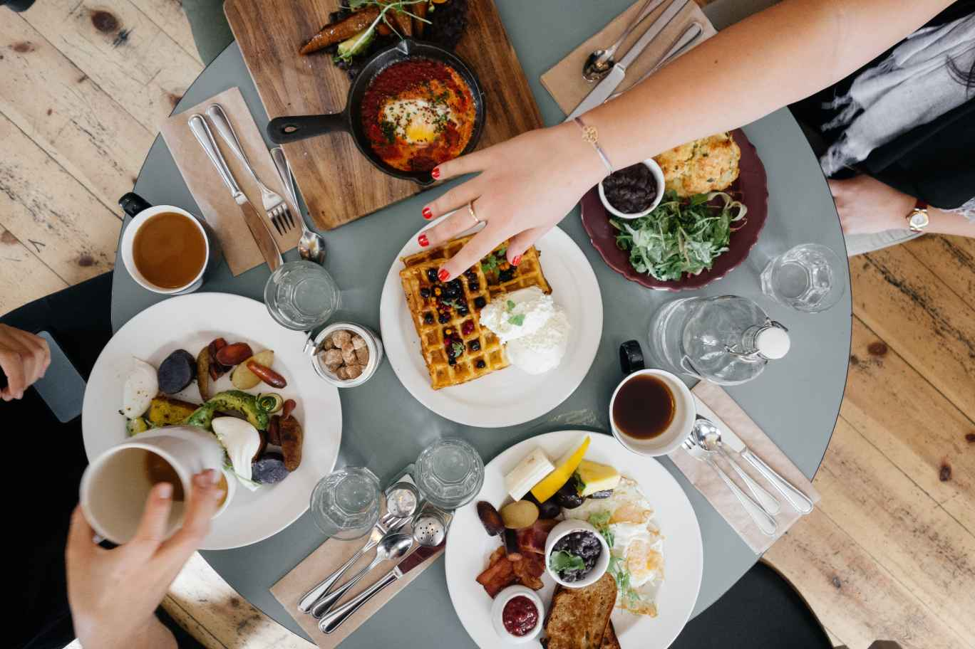
CASE STUDY -1

Slide 2
AGENDA
INTRODUCTION
PROBLEM STATEMENT AND DATA SCIENCE
OBJECTIVE AND METHODOLOGY
SOLUTION DESCRIPTION
IMPACT

Slide 3
INTRODUCTION
A shop near the BTM layout ,Bangalore
A new food supply has got been introduced .
In the beginning the sale was good, but as the months passed proceeded there was loss in sales

Slide 4
Problem statement and data science
A man has took a shop in rent near BTM layout , Bangalore , not in the main road but as a local shop . The rent of the shop is 14000 per month. The man took the shop to sell fast food like- biryani , egg bhujiya , omlets , chicken kabab etc .
To get insights on small businesses about its operational structure and various risk creating factors and developing solutions to drag it towards success.
To know affecting factors which are responsible for decrease in sale.
Finding various options to pull the business back to profit making.
Analyzing optimal expenses values.
Data is collected from Google search.

Slide 5

OBJECTIVE AND METHOLODOGY
To overcome the loss
To reduce the expenses and increase in the sales
Making supply of food in much preferably
Knowing the risk factors and implementing more new methods.

Slide 6
Solution and description
He should start selling his food through online , because in the present world everything is through online.
Timely deliver of food items to the customers needs to be enhanced
staff , serving and cooking environment must be in well maintained space , with proper safety measures .
Costs of food should be manageable by the consumers
Adding some more items in the food menu
Laziness spoils the human. So the person should be active so he can overcome all the loss and implement his business in his own way with his profits

Slide 7
Graph representation
month | Count of expenses | Sum of profit | Count of invested amount | Sum of sales
march | 1 | 50000 | 1 | 135000
april | 1 | 45000 | 1 | 125000
may | 1 | 5000 | 1 | 40000
june | 1 | -30000 | 1 | 45000
july | 1 | -60000 | 1 | 15000
first three months profit and loss |  | 100000 |  | 300000
profit and loss |  | -90000 |  | 60000

Slide 8
food items | Sum of cost/plate
biryani | 60
chicken kabab | 100
egg bhujiya | 35
maggie | 45
omlets | 20
paneer chilli | 80

Slide 9
Impact
Regular and hygiene must be well maintained
Discounts must be given seeing to his profit
About the new shop advertisement must be done with much attractive , so that people will choose food from the new stall
Combo offers should be provided
Feedbacks are main , so that implement in the changes can be done

Slide 10

THE END
Yours faithfully,
-ANUSHMA JOY N

